Slide 1
Cloud based video streaming application
Internship experience in backend and API development

Slide 2
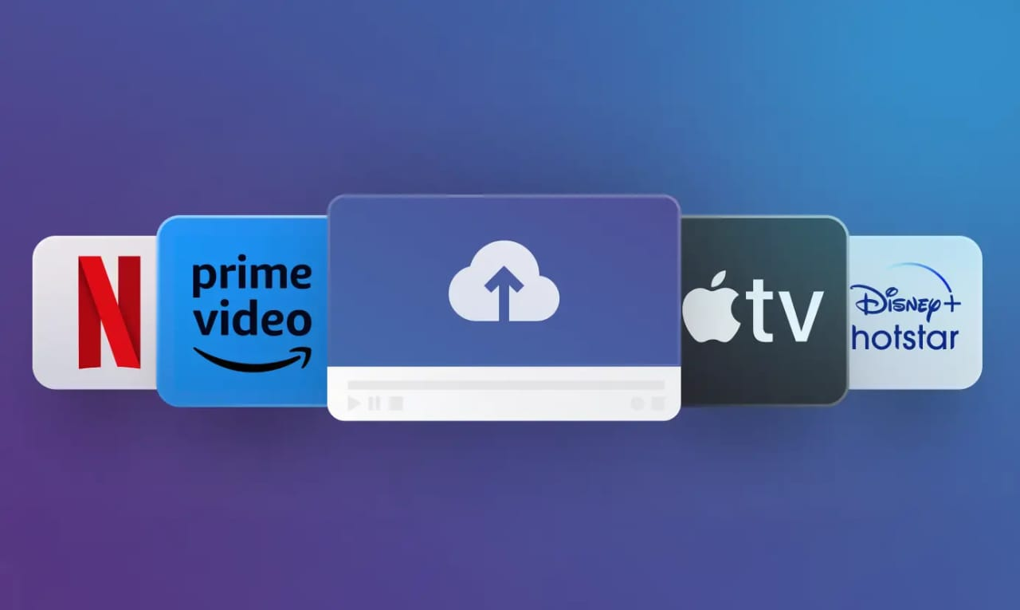

Slide 3
INTRODUCTION TO VIDEO STREAMING:
Video streaming is the delivery of video content over the internet, allowing users to view videos in real-time without downloading them.
Importance of Cloud Computing:
The cloud offers scalability, reliability, and on-demand resource management for video streaming applications.
Internship Overview:
Role focused on backend and API development.
Contribution to designing and developing the infrastructure behind video streaming services.
Technologies Used:
. Backend development, API integration, cloud-based services.

Slide 4

What is Cloud-Based Video Streaming?
.DEFINITION:
A cloud-based video streaming service delivers video content through the internet, using cloud resources to store and distribute content.
BENEFITS:
Scalability: Resources scale according to user demand.
Accessibility: Available on any device connected to the internet.
Reliability: Content is served from globally distributed servers, ensuring high uptime.
Popular Examples:
Netflix, YouTube, Hulu, Amazon Prime Video.

Slide 5
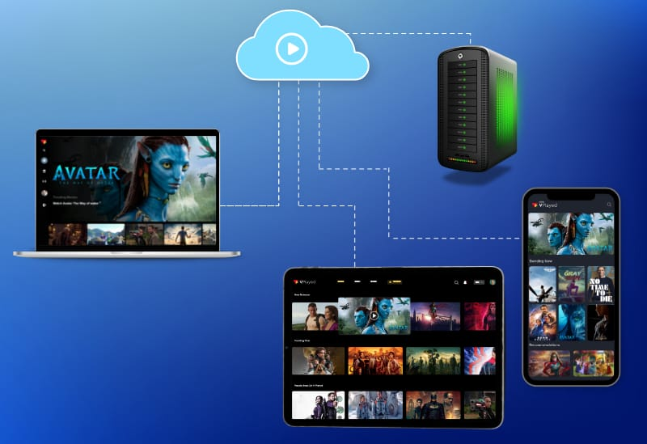
Key Components of a Video Streaming Application
Frontend:
User interface for video playback, search, recommendations, and interactions.
Platforms like web apps, mobile apps, and smart TVs.
BACKEND
Server-side infrastructure that handles data processing, user management, and content storage.
APIs:
Provide communication between the frontend and backend services (user authentication, video data).

Slide 6

Technologies Used in Cloud-Based Video Streaming
Cloud Platforms:
AWS (Amazon Web Services), Google Cloud, Microsoft Azure.
Backend Languages:
Node.js, Python, Java, Go.
APIs:
RESTful APIs, Graph QL.
Database:
NoSQL: MongoDB, Cassandra for scalable data storage.
SQL: MySQL, PostgreSQL for relational data storage.
Video Transcoding:
FFmpeg for transcoding video into different formats for adaptive streaming.
AWS Elemental Media Convert for high-quality transcoding.
.CDN:
.Amazon CloudFront, Akamai for fast global content delivery.

Slide 7
. Backend Architecture for Video Streaming
Microservices Architecture:
Backend is divided into small, independent services for better maintainability.
Separate services for video management, user profiles, playback control.
APIs:
Authentication API: Manages user authentication (JWT, OAuth).
Video Management API: Handles video uploads, metadata, and categorization.
Streaming API: Delivers video content based on user requests using HLS (HTTP Live Streaming) or DASH (Dynamic Adaptive Streaming over HTTP).
Database Management:
Stores video metadata, user profiles, and video statistics.
MongoDB or PostgreSQL for data storage.

Slide 8
API Development for Video Streaming
Role of APIs:
Authentication API: Handles user registration, login, and token management.
Video Upload API: Manages video metadata, categorization, and storage location.
Streaming API: Requests video chunks from the cloud and delivers them to the client in real-time.
Key Considerations:
Efficient data transfer to reduce latency and improve user experience.
Securing APIs to prevent unauthorized access to sensitive user data.
Scalability to handle a large number of requests per second.
Tech Stack:
Express.js for API server.
MongoDB for storing video metadata.
JWT for secure token-based authentication

Slide 9
Challenges in Backend/API Development
Scalability:
Handling millions of concurrent users, especially during peak times.
Latency:
Minimizing video buffering to provide smooth playback.
Security:
Ensuring content is protected from piracy, and user data is encrypted.
API Rate Limiting:
Preventing overload and ensuring that APIs function without delay.
Integration:
Ensuring that APIs work smoothly across multiple devices and platforms (iOS, Android, Web).

Slide 10
Solutions & Best Practices
Load Balancing:
Distribute traffic across multiple servers to ensure that no single server is overwhelmed.
CDN Integration:
Use CloudFront, Akamai, or similar services to distribute video content globally, reducing latency.
Caching:
Implement caching strategies at various levels (API, CDN) to minimize database load and reduce latency.
API Optimization:
Use asynchronous APIs and pagination to manage large datasets and reduce client-side wait times.
.Security Measures:
HTTPS for secure communication.
OAuth and JWT for secure authentication.
Encryption of sensitive data.

Slide 11
Conclusion & Future Prospects
Summary:
Key takeaway: The cloud and APIs play a critical role in making video streaming scalable and efficient.
Future Trends:
AI/ML Integration: Personalized recommendations, content prediction.
Video Compression: New codecs for higher quality and faster streaming.
Edge Computing: Placing resources closer to users for reduced latency.

Slide 12


